Slide 1

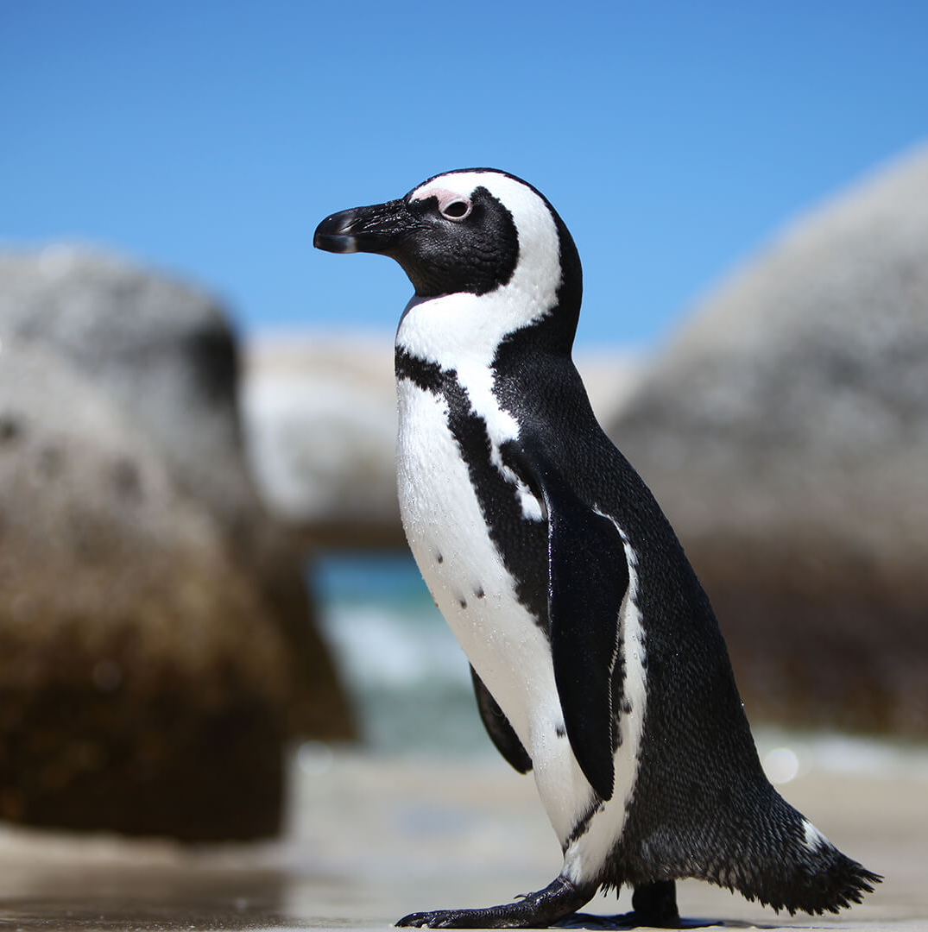

Group 30: Moulting stage Penguin Monitoring System
EEE4113F 2025

Slide 2
Team Introduction
Dichochi Ramotlou
Philasande Ngema
Tohlang Rakhaphu

Slide 3
Problem Background
Critical Endangerment
African Penguins are on track to become extinct by 2035 if current trends continue.
The Moulting Challenge
They Undergo a 21-day catastrophic moult, during which they they shed and regrow their feathers
Conservation Data Needs
Conservation relies on monitoring physiological changes such as weight and health during moulting.
Moulting is asynchronous→ system must monitor year-round.
Individual Data Matters
With the population shrinking, tracking individual penguins is essential for targeted conservation strategies.

Slide 4
Objectives
Smart Monitoring System
Implementation of an integrated system that automatically collects physiological data to track the moulting progression of individual penguins.
Remote User Interface
Develop an interactive platform that allows researchers to remotely monitor and analyse moulting data in real time.
Long-Term Data Storage
Implement a data storage system to retain individual penguin records, enabling the analysis of long-term health trends and supporting conservation strategies.

Slide 5
System Overview
Mechanical subsystem
Scale Housing & Calibration as well as placement of all hardware components
Electrical Subsystem
Integration of all hardware components and the packaging of collected individual penguin data that is transmitted to a remote server
User Interface & Data Storage
Involves creating a server and user interface that enables researchers to track
moulting progression. Includes experiments in implementing machine learning models for penguin identification and moulting stage estimation.

Slide 6
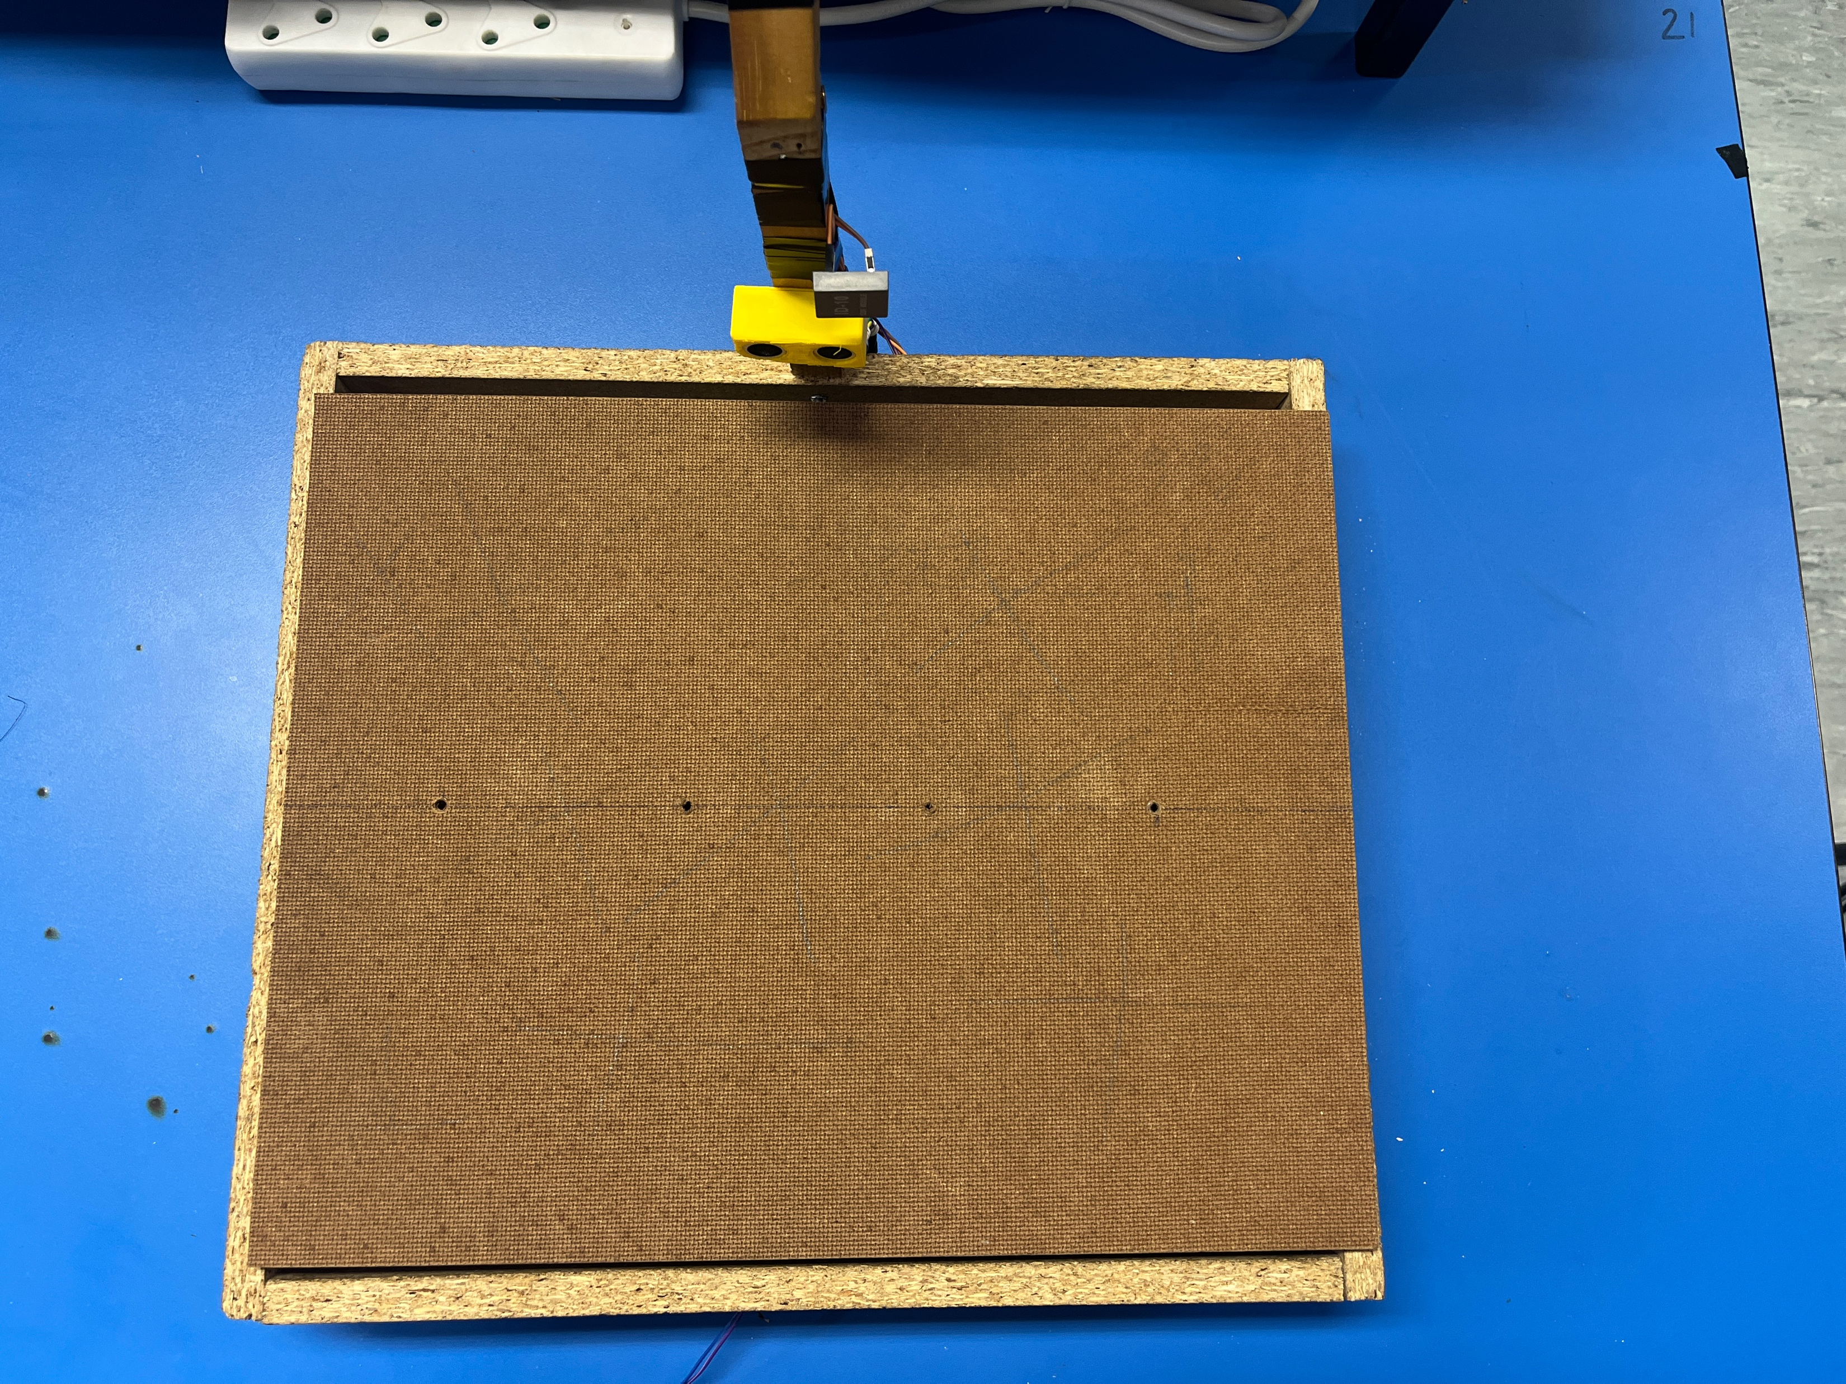
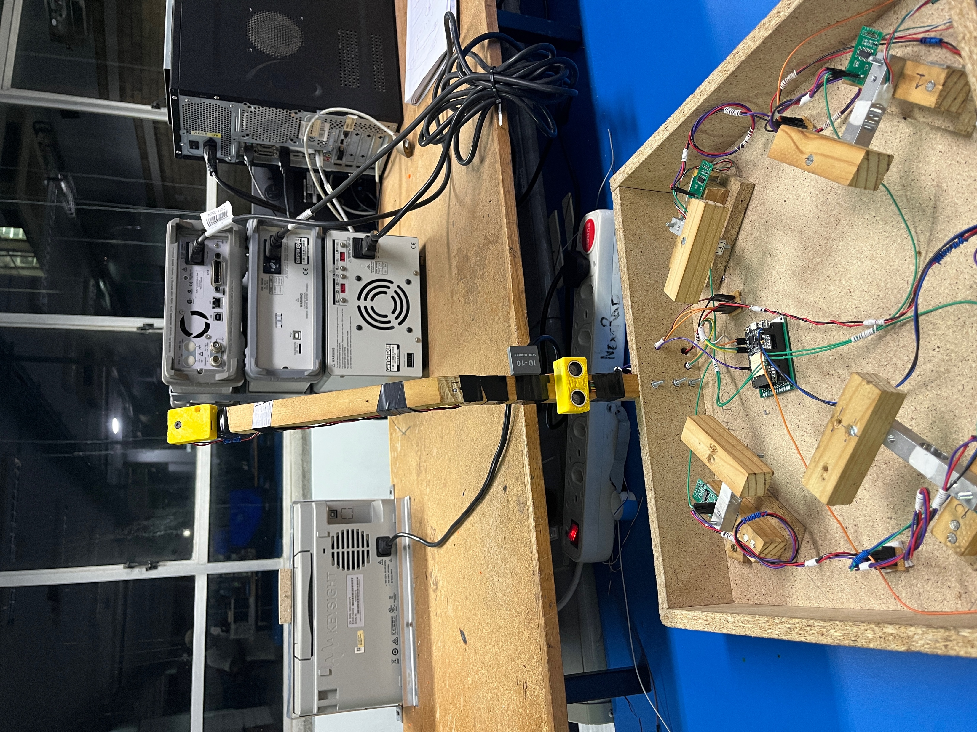
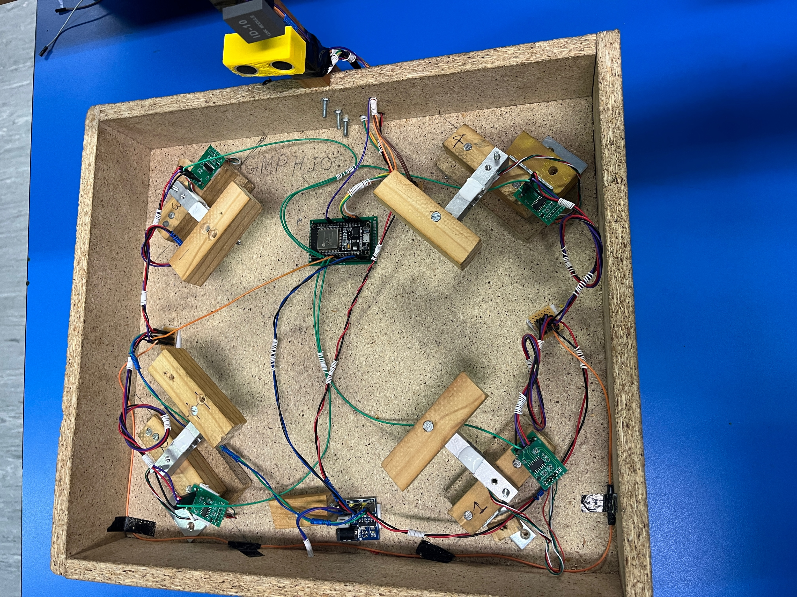
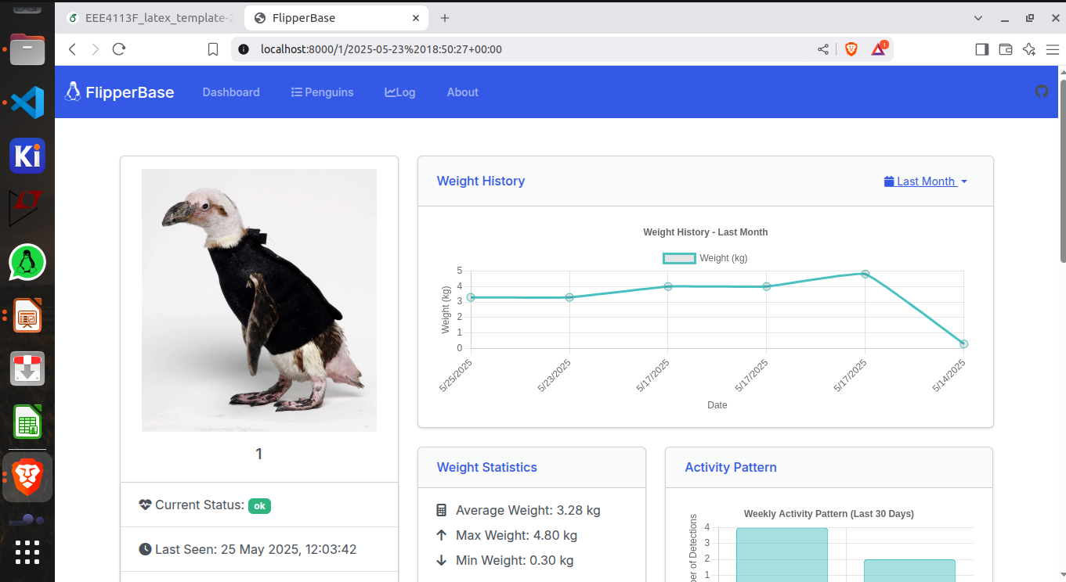
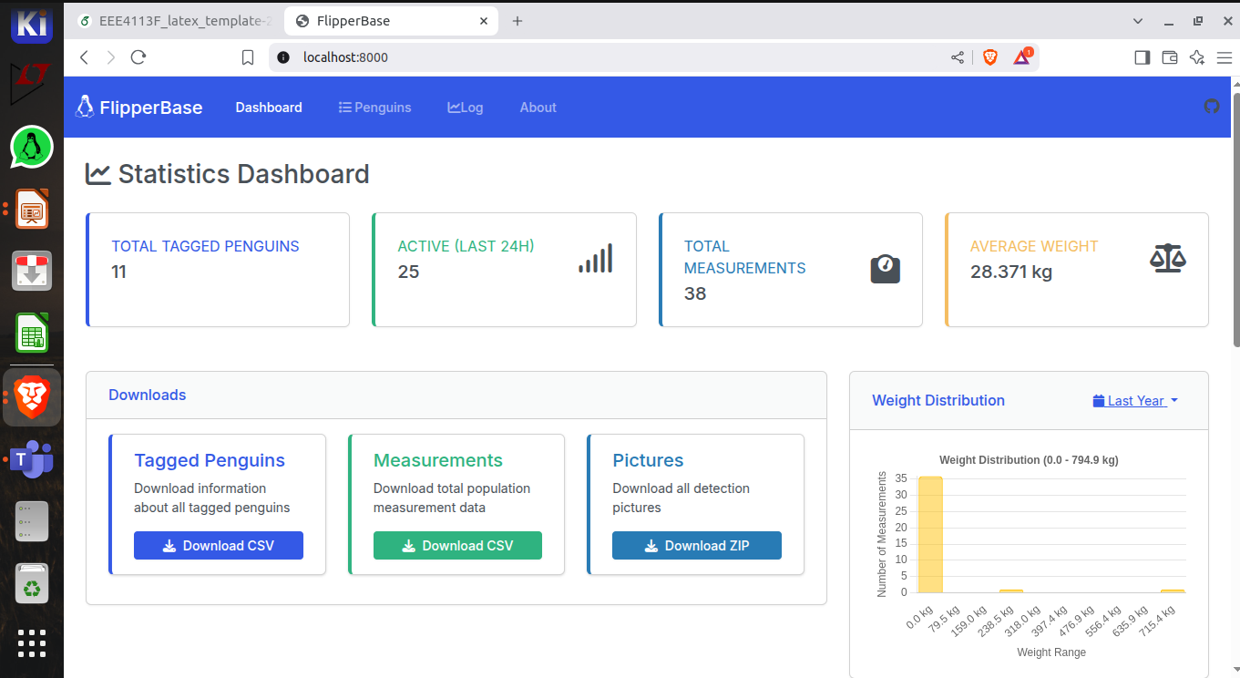
Final Solution

Slide 7
Adaptability & Deployment Considerations
Designed for remote setup
Non Invasive
Scalability to other penguin colonies or bird species
Low maintenance, solar/battery powered operation

Slide 8
Conclusion & Future Work
Valuable Long-Term Insights
Enables collection of individual-level, long-term data — essential for analysing species health trends over time.
Hybrid Identification Approach: Camera+RFID
Future enhancement: Integrate machine learning-based image recognition
Ideal for Moulting Behaviour
Automated, non-invasive data collection suits moulting penguins’ low mobility
Key Requirements Met
Works in remote environments
Focuses on individual penguins
Ensures non-invasive monitoring
Supports year-round automated data gathering

